Slide 1

Good afternoon!

Slide 2
[p]
Peter Piper picked a peck of pickled peppers;
A peck of pickled peppers Peter Piper picked.
pick – собирать
a peck - пучок
pickled - маринованный

Slide 3
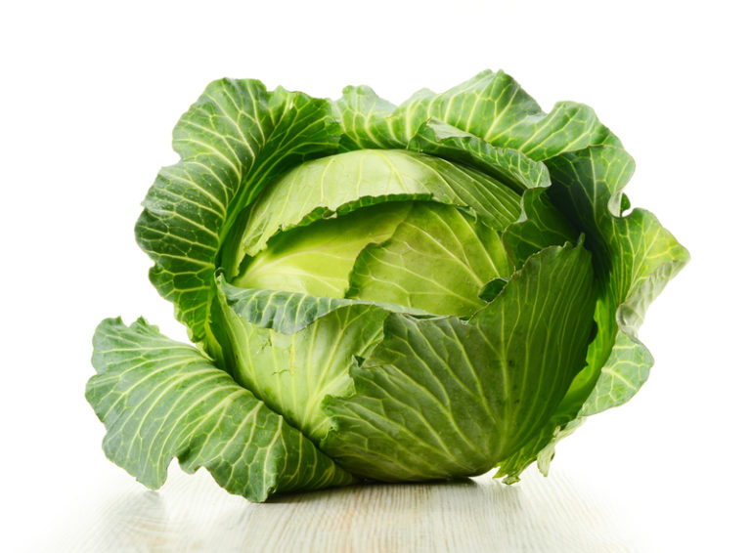
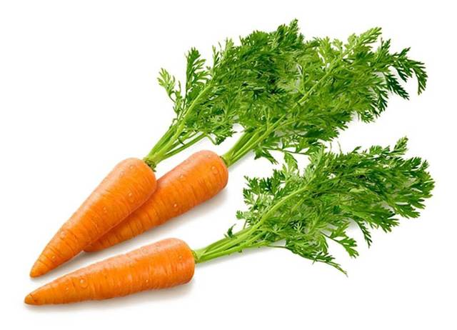
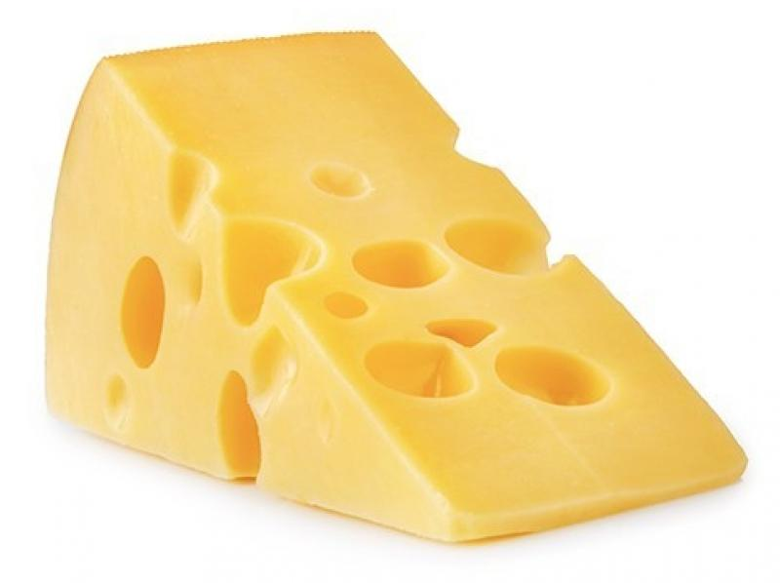
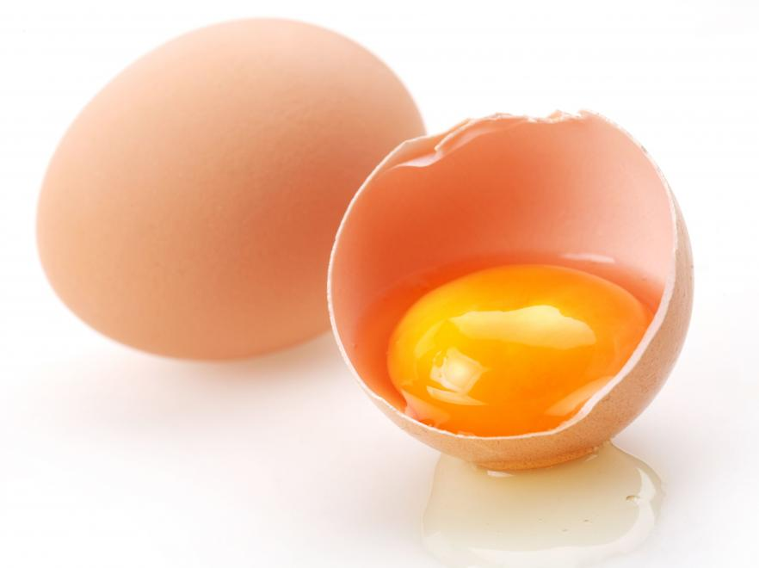
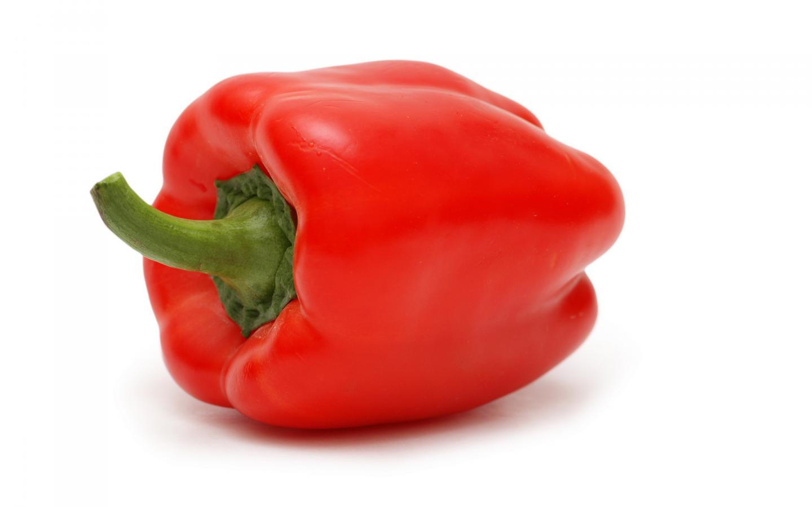

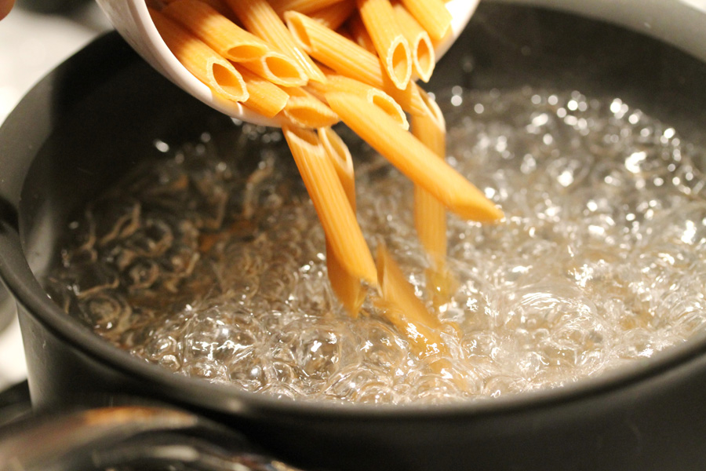
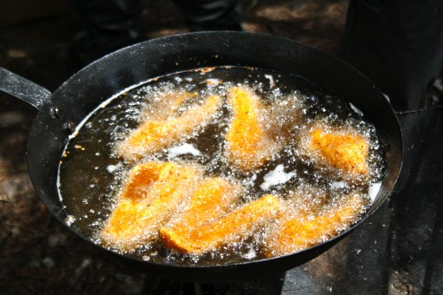
big
bigger
the biggest

Slide 4



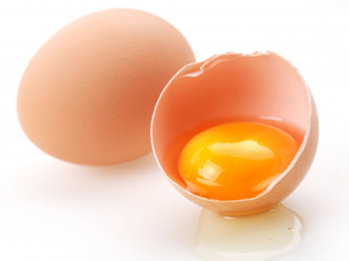



a cabbage
a carrot
cheese
an egg
a pepper
to boil
to fry

Slide 5
A)
B)
to boil
a egg
a carrot
a pepper
cheese
cabbage
to fry
C)
D)
E)
F)
G)

Slide 6
Example: I like to eat cabbage.
I like to My favourite food I don`t like to His sister | is eat can fry\ boil | cabbage a carrot a pepper cheese eggs

Slide 7
small
- smaller
- the smallest
big
- bigger
- the biggest
tasty
- tastier
- the tastiest
grey
- greyer
- the greyest

Slide 8
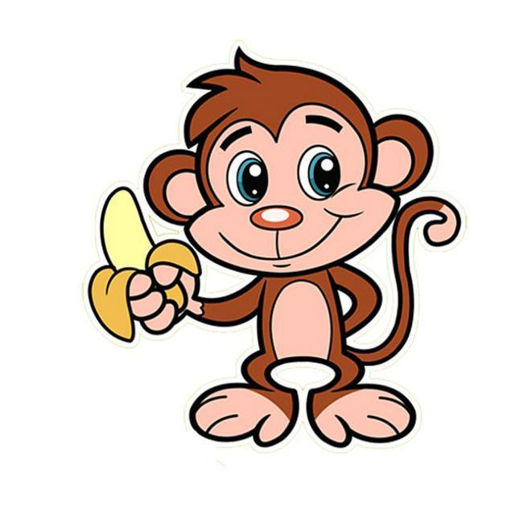
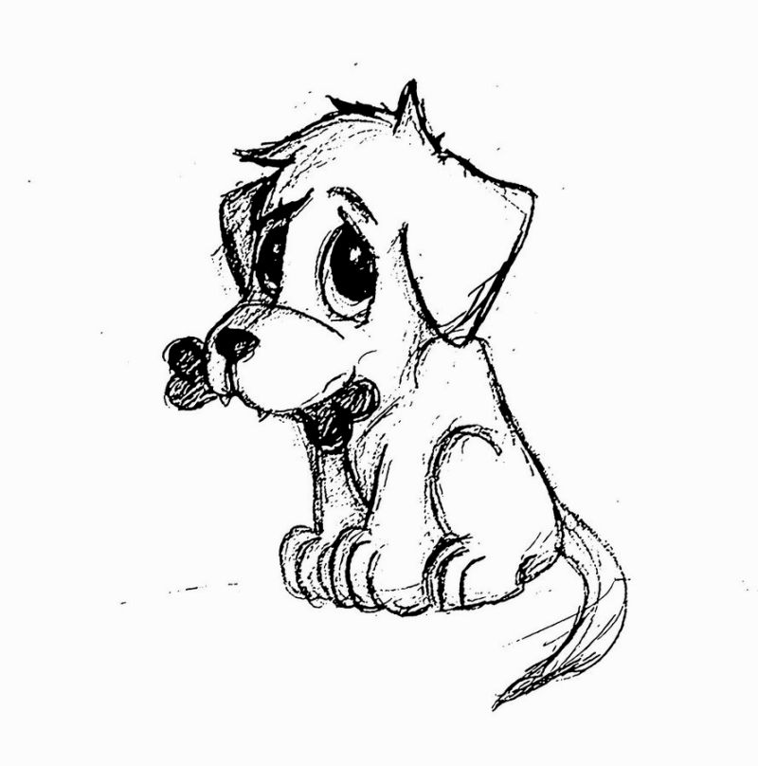
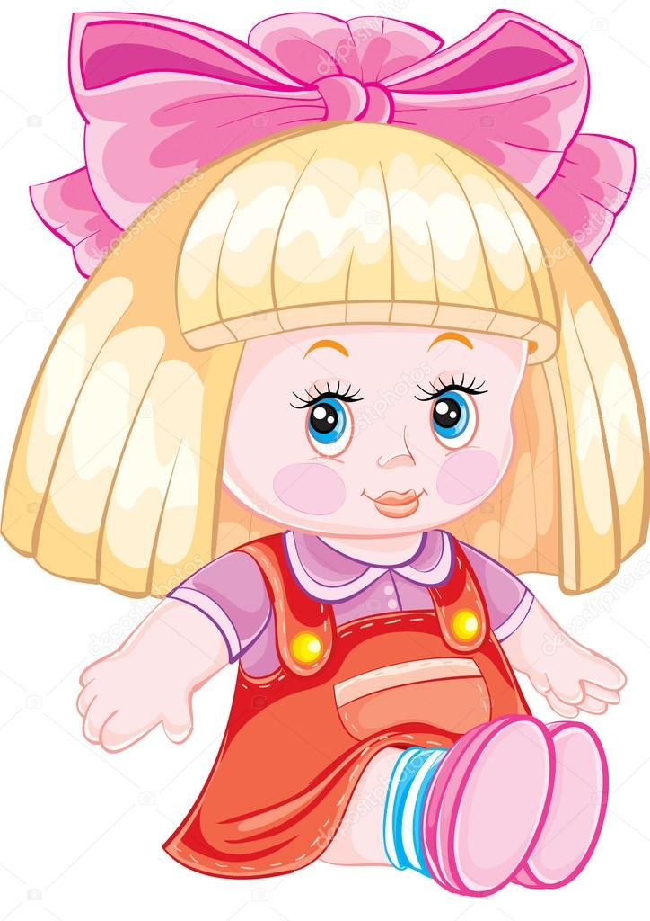
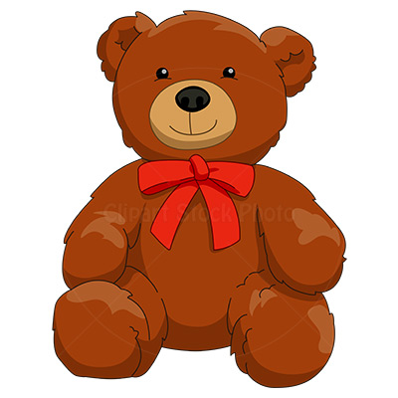
A monkey is funnier … a dog.
The doll is … tall … the teddy bear.
then
as
as

Slide 9
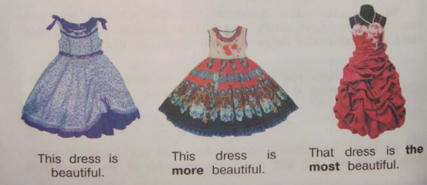

Slide 10
interesting favourite popular fantastic exciting famous
This book is the most exciting.
This book is more popular than that book.

Slide 11
Положительная | Сравнительная | Превосходная
beautiful | more beautiful | the most beautiful
comfortable | more comfortable | the most comfortable
expensive | more expensive | the most expensive
wonderful | more wonderful | the most wonderful
dangerous | more dangerous | the most dangerous
intelligent | more intelligent | the most intelligent
difficult | more difficult | the most difficult
modern | more modern | the most modern
useful | more useful | the most useful
generous | more generous | the most generous

Slide 12
Have – had – had
Tell – told -told

Slide 13
Home task:
выучить новые слова на странице 16, упр. 8.

